Slide 1
Understanding Complex Networks
Chapter 9

Slide 2
Learning Objectives
Discuss interconnectivity issues in multivendor environment
Define various options to implement multivendor network environment
Discuss differences between centralized and client/server computing
Define client/server networking environment
Discuss basics of Web-based computing environments

Slide 3
Interconnectivity in Multivendor Environments
Today’s networks include computers and equipment from various vendors
Big dilemma is connecting systems using different network operating systems
Server’s operating system, client’s operating system, and redirectors must be compatible
Figure 9-1 shows that Windows 2000 supports many different client operating systems

Slide 4
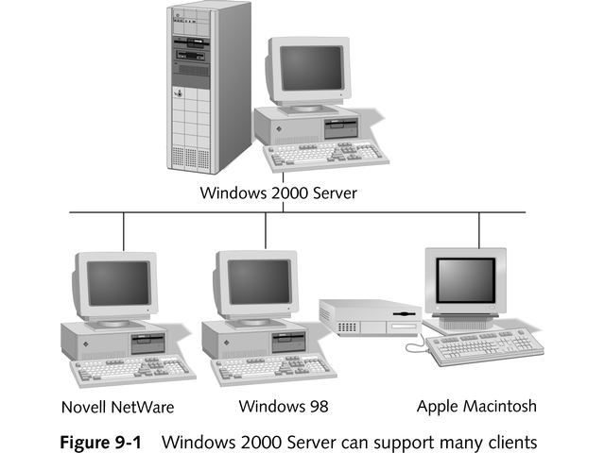
Windows 2000 Server Supports Many Clients

Slide 5
Implementing Multivendor Solutions
Two basic ways to handle multivendor connectivity
From client end
From server end

Slide 6
Client-Based Solutions
Client’s redirector intercepts messages and forwards them to correct server
Client-based multivendor solution
Multiple redirectors loaded onto single client
Allows connections to different vendor’s servers
Figure 9-2 shows redirectors in multivendor environment

Slide 7
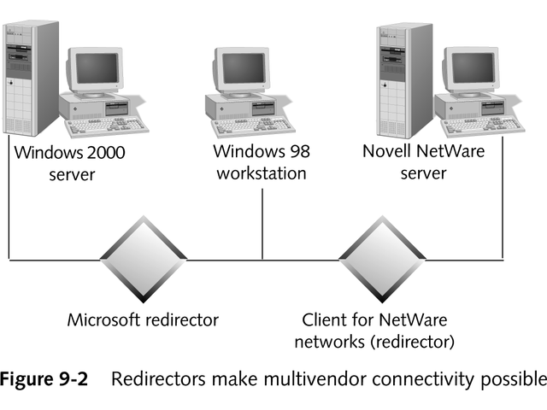
Redirectors Make Multivendor Connectivity Possible

Slide 8
Server-Based Solutions
Server-based multivendor solution
Software loaded on server to provide service to particular client
Service for Macintosh installed on Windows server allows Macintosh clients
Service automatically converts files to Macintosh format when retrieving them from server
See Figure 9-3

Slide 9
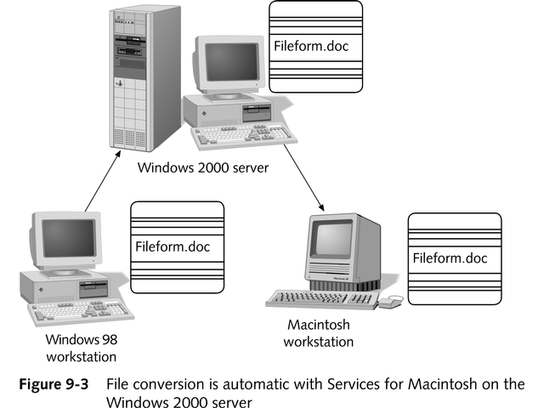
Service for Macintosh on Windows 2000 Server

Slide 10
Vendor Options
Many NOSs are available from vendors
Four most popular networking product vendors are:
Microsoft
Novell
Linux
Apple
Many include utilities to allow simple interconnectivity
See Figure 9-4

Slide 11
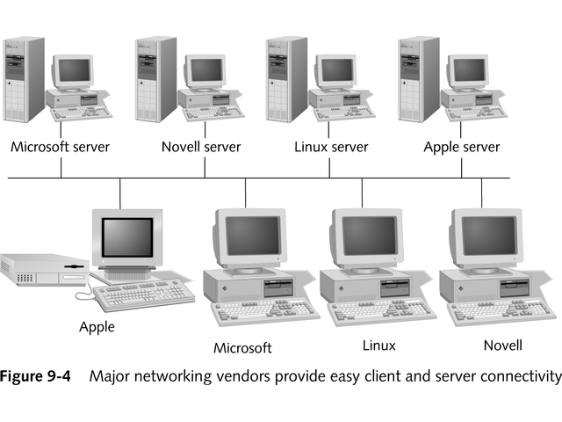
Easy Client and Server Connectivity

Slide 12
Microsoft Redirector
Microsoft redirector included with most Microsoft operating systems
Automatically installed when operating system is installed
Allow users to share resources with others on network (peer-to-peer networking)

Slide 13
Microsoft in a Novell Network
Many products allow Windows client to connect to Novell NetWare network, including:
NWLink
Client Service for NetWare (CSNW)
Microsoft Service for NetWare Directory Services

Slide 14
MS-DOS Clients
Utilities allow MS-DOS client to connect to servers of different NOS vendors, including
AppleShare PC
LocalTalk card with firmware
UNIX-derived client software, such as Sun Microsystem’s PC-NFS
Samba, add-on Linux server

Slide 15
Novell Networks
Provides file and print services for following clients:
MS-DOS-based
Windows 9x and ME
Windows 2000, XP, and NT
Apple Macintosh
UNIX/Linux
NetWare 6 includes platform-independent method for accessing file and print servers, as seen in Figure 9-5

Slide 16
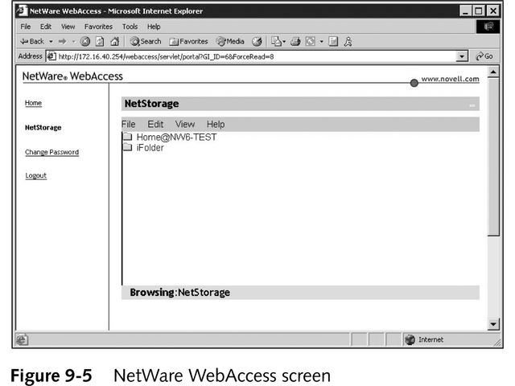
NetWare WebAccess

Slide 17
Linux Networks
Network File System (NFS)
Lets networked machine export portion of local file system to authorized users on network
Exported part known as mount point or NFS volume
Preferred method of interconnection is adding Samba service to Linux servers
Open-source server-based solution
Allows Linux machine to masquerade as native Microsoft network server

Slide 18
Apple Macintosh
Includes OS files to communicate with AppleTalk network
AppleShare automatically provides file sharing
Includes print server to share printers

Slide 19
Mac OS-X
Newest version is major departure from previous Mac OS versions
Includes client software for Windows and UNIX environment
Built on UNIX core
Backward compatible support

Slide 20
Handheld Computing Environment
Fragmented market with no clear hardware or software standard
Challenge to integrate handheld devices into corporate computing environment
Devices rarely connect to corporate LAN, but most offer Ethernet connection
Concern for security and data integrity
Software companies have programs for handling synchronization, backup, and application loading

Slide 21
Centralized versus Client/Server Computing
Centralized computing
Mainframes perform all processing
Dumb terminals connect directly to mainframe
PCs and “thin clients” attach to terminal server
Greatly increases network traffic
Client/server computing
Replacing many centralized applications

Slide 22
Understanding Terminal Services
Allows clients to run complex applications on thin client or bare bones PC
Transfers burden of processing to server
Server sends screen updates to client
Good for older PCs, thin clients, and remote users on slow connections
Requires servers with large amounts of RAM, extensive hard disk space, and powerful CPUs

Slide 23
Thin-Client Computing
Thin-Clients connect to server to access resources and run applications
Many advantages of thin clients, including
No removable storage so employees cannot copy files or introduce viruses
No hard drive reduces viruses and provides better reliability
Lower total cost than desktop PCs

Slide 24
Back to the Future: The Mainframe Environment
Today, certain transaction-intensive applications work well with mainframes
Uses include large-scale airline, hotel, and rental car applications
Mainframes remain viable processing model
Still important computing resource today and for foreseeable future

Slide 25
Client/Server Environment
Most popular network communications method
Easy implementation and scalability
Client requests access to shared network resources from server
Usually both client and server share processing
World Wide Web is most prominent client/server model

Slide 26
Client/Server Model in a Database Environment
Database management systems (DBMSs) are example of efficient client/storage model
Client uses Structured Query Language (SQL) to manipulate data using English-based language instead of cryptic programming language
Two major components in SQL environment
Application, referred to as front end or client
Database server, referred to as back end or server
See Figure 9-6

Slide 27
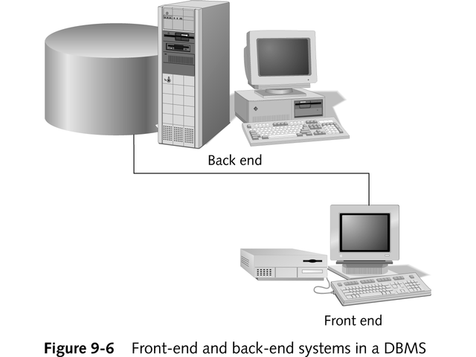
Front-End and Back-End Systems in a DBMS

Slide 28
Client/Server Architecture
Number of ways to implement client/server environment
Figure 9-7 shows two of most common:
Single database server
Multiple database servers (distributed or multitiered database)

Slide 29
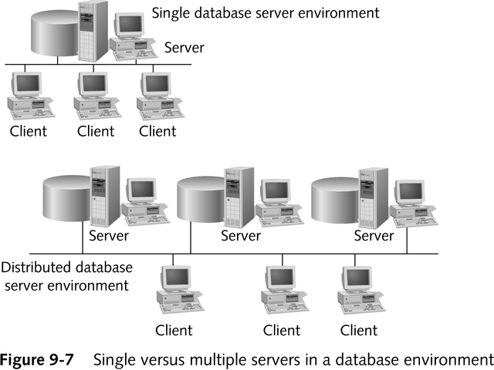
Single Versus Multiple Servers in a Database Environment

Slide 30
Advantages of Working in a Client/Server Environment
Uses computers more efficiently, both front end and back end
Client computer can have smaller hard drive and less RAM than server
Centralized location of data on server provides more security
Simplifies back-up process

Slide 31
Web-Based Computing Environments
Many operating systems, such as Novell NetWare 6, make file and print server available over Web browser
WebDAV is emerging technology that provides single framework for all client and server platforms
Extension to HTTP protocol lets browser do traditional file system tasks, including reads, writes, locking, and version control
In future, WebDAV may eliminate redirectors, FTP, and e-mail clients
See www.webdav.org for more information

Slide 32
Chapter Summary
Interconnectivity between multiple-vendor operating systems is becoming increasingly necessary in networking
Two ways to connect multivendor environments ease the stress of making these connections
Client-based multivendor network environment relies on client computer’s redirectors to decide which server should be sent the request

Slide 33
Chapter Summary
If a computer requires connections to both NetWare server and Windows 2000 server, load software to connect to both servers
In server-based solution, server supports multiple client types
Computer running Windows 2000 Server can support Microsoft, Novell, or Apple clients
Four major networking product vendors and organizations—Microsoft, Novell, Linux, and Apple—support connectivity to each other’s NOSs

Slide 34
Chapter Summary
Using processing power of mainframe computer creates centralized computer environment
Centralized computing can generate large amounts of network traffic without exploiting the power of today’s PCs
It is not well suited for typical user productivity applications, such as word processing, spreadsheets, and e-mail

Slide 35
Chapter Summary
Mainframes still play valid role in modern networks, especially for large-scale, transaction-oriented applications
Server-based terminal service provide useful access to networks and centralized server-based resources for remote users or for single-user workstations
Handheld computing environment is growing

Slide 36
Chapter Summary
Non-standardized hardware and software used with handheld devices pose challenges
In client/server environment, PC and server share processing and use resources of both machines more efficiently
WWW is good example of client/server networking environment
When you ask for Web page, browser in client asks server to send page

Slide 37
Chapter Summary
Client/server environment reduces network traffic
Most database management systems use SQL as query language.
Database application resides on client or front end, while server or back end stores and maintains data

Slide 38
Chapter Summary
Trend in today’s networking environment is to remove obstacles and incompatibilities of working in multivendor environment
WebDAV, a promising new technology, hopes to make any Web-enabled device a client to file-sharing, e-mail, and calendaring applications

